Slide 1

3M/MDE Forum on Science and Engineering Education 2012
3M Innovation Center
October 31, 2012
Wireless user name 78557
Password mmm

Slide 2
Welcomes
Kim Price
Vice President, 3M Community Affairs
and 3M Foundation
Beth Aune
Director, Academic Standards and Instructional Effectiveness
Minnesota Department of Education
“Leading for educational excellence and equity.
Every day for every one.”
Notes:
Kim: 3M’s interest in science education, fit with 3M’s mission of innovation, Programs 3M supports
Beth: Thank 3M Support MDE provides to schools and teachers for improving learning (could build off mission statement)
- Standards
- Best Practices

Slide 3
Introduction to the Workshop
John Olson, Science Content Specialist, Minnesota Department of Education
Goals
Understand new developments about science and engineering learning
Experience emerging science instructional practices
Develop plans for introducing and incorporating these practices in your district, school and education programs.
Notes:
Thank you for coming and fitting this event into your Halloween plans. This was the only day available on 3M’s schedule
Exciting time for science and engineering education – culmination of years of science education research and thinking. You are a most importance audience, because you carry the message to teachers and future teachers.
Who is in the audience? – District leaders – science, higher Education Faculty, Professional Development providers (include informal ed) Teachers
Go through Agenda – point out presenters (resources during the day),
Slides will be available for on a website we will announce later
Video recording for educational use – such as online PD. If you would be excluded from the video talk to Doug
Parking lot for questions

Slide 4
Turn and Talk
  What should all students learn in science to be productive citizens?
  ( 2 minutes)
Notes:
Consider both skills and knowledge
2 minutes
Point out Critical Listeners will provide examples
One or two ideas from each listener
This question and these ideas will serve as the focus for our day

Slide 5
Context for our Workshop
Previous National Science Standards – 1990s
  Benchmarks for Science Literacy
  National Science Education Standards
Minnesota Academic Standards in Science
  2003
  2009 (implemented 2011-12)
  Next Revision 2017-18
National interest in new standards
Notes:
National standards – thinking around science education for all students
Mn Transition from profile of learning
- Concern for reduction in content, use of new ideas around learning progressions

Slide 6


New “national” science standards
- a two-step process
State
Standards
Notes:
1st – get the science right – the most important concepts and skills
2nd – standards that could be adopted by states

Slide 7

A new Vision of Science Leaning that leads to a new Vision of Teaching.
free download at
www.nap.edu
Notes:
Foundational document - Vision for science education
Summer 2011
Available free
More later the background research and how it was written

Slide 8
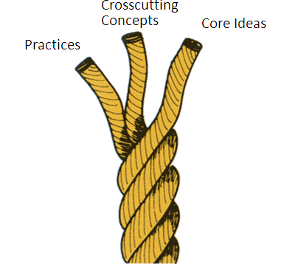
Three Dimensions of Science Learning
Scientific and Engineering Practices
Crosscutting Concepts
Core Ideas
Notes:
Key theme – good science learning consists of 3 dimensions. They should come together in to coherent and meaningful way, both for the student and the teacher. We will look at them separately but they should be integrated in instruction
SEP – the skills for doing science – like do investigations, constructing explanations, communicating ideas, and using mathematical thinking,
– consideration for what scientists actually do,
skills for science inquiry and also being a thoughtful person
CCC – Concepts that cut across many disciplines, like patterns, cause and effect and energy
CI – the main concepts for life, earth and physical science that we want students to learn and be able to use.
Today will explore the first two.
The Framework describes these ideas, how they develop over time, how they could be taught and how they could be written into standards.

Slide 9
Science and Engineering Practices
Doug Paulson
STEM Integration Specialist
John Olson

Slide 10
Why Practices?
Emphasizes outcomes from instruction.
References both scientific inquiry and engineering design.
Notes:
A few practical reasons as well…standards are about the skills and knowledge a student should achieve as a result of their education (the outcomes), NOT about the instructional methodology used to engage them in the classroom. Inquiry has had both meanings which causes confusion in regards to the role of standards; the term “practices” helps to convey the emphasis just on the desired outcomes. Additionally, inquiry is used almost exclusively in science; the term “practices” encompasses both scientific skills and engineering design skills.

Slide 11
Science and Engineering Practices
1. Asking Questions (Science) and Defining Problems (Engineering)
2. Developing and Using Models
3. Planning and Carrying Out Investigations
4. Analyzing and Interpreting Data
5. Using Mathematics, Information and Computer Technology, and Computational Thinking
6. Constructing Explanations (Science) and Designing Solutions (Engineering)
7. Engaging in Argument from Evidence
8. Obtaining, Evaluating, and Communicating Information
Framework Page 42
Notes:
This slide is like an earlier slide but now there is an emphasis on the engineering connections. The 8 practices of science and engineering should not be taken as discrete. They happen together or in conjunction. They are not a sequence that is followed in a stepwise manner, rather as set of practices that students should engage in as science.
Need to discuss the science and engineering parts on 1 and 6 -- Science and engineering practices are very similar (hence the NRC talks about them together using the same language) except for their differences in purpose (#1) and products (#6). But even in those practices science and engineering are about understanding the world (natural vs. designed) and attending to evidence as a way of knowing (to explain and to craft solutions).
The discussion should connect back to the activity. Discuss the role of evidence in explanation. Move the discussion toward how these practices are connected to one another.

Slide 12
Why Practices?
First – It minimizes the tendency to reduce scientific practices to a single set of procedures, such as identifying and controlling variables, classifying entities, and identifying sources of error.
Second – Avoids the mistaken impression that there is one distinctive approach common to all science—a single “scientific method”—or that uncertainty is a universal attribute of science.
Third – Science should be taught through a process of inquiry have been hampered by the lack of a commonly accepted definition of its constituent elements.
Framework Page 48
Notes:
The practices in isolation from the content provides little meaning to these practices. Research has clearly shown that students effectively learn content through engaging in/in conjunction with learning practices.
The focus in the Framework is on important practices, such as modeling, developing explanations, and engaging in critique and evaluation (argumentation), that have too often been underemphasized in the context of science education. Students engage in argumentation from evidence to understand the science reasoning and empirical evidence to support explanations.

Slide 13
Science and Engineering Practices
Science Practices are the process and habits of mind specific to doing science.
Science Practices distinguish science from other ways of knowing.
When students actively engage in Science Practices they deepen their understanding of core science ideas.
This vision of the Core Ideas and Practices in science provides the utility students need to engage in making sense of the natural and design worlds.
Notes:
Evidence is the underlying tenet for science and the central unifying idea of the practices.
Highlight that both attend to evidence as a way of knowing. There are other ways of knowing (emotional, cultural, perceptual), but science and engineering share this attention to and value of empirical evidence.

Slide 14
Understanding How Scientists Work
First - It minimizes the tendency to reduce scientific practices to a single set of procedures, such as identifying and controlling variables, classifying entities, and identifying sources of error. This tendency overemphasizes experimental investigation at the expense of other practices, such as modeling, critique, and communication.
Second - A focus on practices (in the plural) avoids the mistaken impression that there is one distinctive approach common to all science—a single “scientific method”—or that uncertainty is a universal attribute of science.
Third - Attempts to develop the idea that science should be taught through a process of inquiry have been hampered by the lack of a commonly accepted definition of its constituent elements. The focus in the Framework is on important practices, such as modeling, developing explanations, and engaging in critique and evaluation (argumentation), that have too often been underemphasized in the context of science education. Students engage in argumentation from evidence to understand the science reasoning and empirical evidence to support explanations.
Notes:
The red text is where the emphasis lies. Do not read the page, but focus on the three pieces of text in red.
The practices taken in isolation from the Core ideas and Crosscutting concepts have little meaning; these concepts work together.

Slide 15
Science and Engineering Practices
  Activity 1) Explanations from Evidence (polymer)
Notes:
Transitions to the first dimensions. We will be doing some activities to support thinking about how these ideas will look in the classroom and to consider deeper implications for the changes.

Slide 16
Evidence to Support Explanations
What distinguishes science from other ways of knowing is the reliance on evidence.
Value and use science as a process of obtaining knowledge based on empirical evidence.
Notes:
The role of evidence is essential to science. There are many ways of knowing, science is a way of knowing that is predicated on evidence. Other ways of knowing use emotion, the arts or faith, religions as ways of knowing. Science just happens to be a very powerful and reliable way of knowing where replication is required in science.
Science is not a democratic process, we do not vote on science, it is determined by evidence.

Slide 17
Polymer Science Practices - Activity 1
Group Activity
Add a spoonful of the Borax powder with the cup of water and stir it with wooden stick.
Fill the other small cup with about 1 inch (2.5 cm) of the glue. Add the film canister of water and stir
Add one spoonful of the Borax solution you made earlier and stir well.
Formulate questions and investigate explanations of the observed phenomena. (Ex. Does it have properties of a solid or a liquid?)
Develop and use evidence to supports your explanations.
Individual Activity
4. Write in your journal your explanation that can be used to communicate to others your explanation for this phenomena and the describe the evidence to support your explanation.
Following Discussion
Reflect on the nature of instruction that leads students to develop explanations based upon evidence.
Notes:
This will take about 25 minutes. The purpose is to model instruction that targets using evidence to support explanations
Use Talk and Argument to make thinking visible.
Focus on evidence to support explanations.
Some will Google explanations, but these will not include evidence to support the explanations.
MATERIALS
Plastic tubs or basins to catch spills
Bucket or pitcher of water
Plastic cups of various sizes
Plastic Tubes of ¼ to ½ inch in diameter and of various lengths (10 cm to 50 cm)
Measuring cups or other measuring devices
The discussion that follows the activity is key to this activity. Making thinking visible is key to doing this. Extend thinking through all of the strategies on page 91 of the book Ready, Set Science.
Using evidence to support explanations in the discussion supports argument as a science practice. Be sure to travel around the room to listen into discussions to prepare for the discussion. Two general hypothesis generally emerge (cohesion of water and air pressure). Force the discussion toward providing evidence. The key is what evidence is used to explain.
The investigation as groups will require 15 minutes, the individual portion 5 minutes.
The Talk and Argument portion of this lesson should take about 15 minutes. Begin by having a few read their explanations.
Do not confirm, but extend thinking. This is a good activity to have before the first break.

Slide 18
What is the Role of Investigations in the Classroom?
Student – Planning and Carrying out Investigations
Providing empirical evidence to support assertions
Listening to others’ arguments and analyze the evidence
Evaluating arguments based on evidence and reasoning
Developing own explanations based on evidence
Communicating findings
Teacher – Engaging students in practices
Making student thinking visible using argumentation, writing and models.
Assessing student understanding to support student reasoning and sense making.
Evaluating student explanations of Core Ideas used in the explanations.
Notes:
Thinking about the investigation of the siphon in a classroom. What is the role of each of the actors?
Investigation to develop evidence to…
Supporting explanation to…
Engage in argument from evidence
Evaluating and Communicating information and findings.

Slide 19
Science and Engineering Practices
1. Asking Questions (Science) and Defining Problems (Engineering)
2. Developing and Using Models
3. Planning and Carrying Out Investigations
4. Analyzing and Interpreting Data
5. Using Mathematics, Information and Computer Technology, and Computational Thinking
6. Constructing Explanations (Science) and Designing Solutions (Engineering)
7. Engaging in Argument from Evidence
8. Obtaining, Evaluating, and Communicating Information
Framework Page 42
Notes:
This slide is like an earlier slide but now there is an emphasis on the engineering connections. The 8 practices of science and engineering should not be taken as discrete. They happen together or in conjunction. They are not a sequence that is followed in a stepwise manner, rather as set of practices that students should engage in as science.
Need to discuss the science and engineering parts on 1 and 6 -- Science and engineering practices are very similar (hence the NRC talks about them together using the same language) except for their differences in purpose (#1) and products (#6). But even in those practices science and engineering are about understanding the world (natural vs. designed) and attending to evidence as a way of knowing (to explain and to craft solutions).
The discussion should connect back to the activity. Discuss the role of evidence in explanation. Move the discussion toward how these practices are connected to one another.

Slide 20
Engineering Practices
These practices are a natural extension of science practices.
Science instruction often includes opportunities for students to engage engineering practices.
Notes:
Engineering Practices are generally a new concept for many states or have been used in very different ways on other states. This should focus on the Framework descriptions of Engineering Practices.
The inclusion of core ideas related to engineering, technology, and applications of science reflects an increasing emphasis at the national level on considering connections between science, technology, engineering, and mathematics. It is also informed by a recent report from the NRC on engineering education in K-12, which highlights the linkages—which go both ways—between learning science and learning engineering. Just as new science enables or sometimes demands new technologies, new technologies enable new scientific investigations, allowing scientists to probe realms and handle quantities of data previously inaccessible to them.

Slide 21
Building Interest in Science
The line between applied science and engineering is fuzzy.
The Framework seeks ways for science and engineering to be used to investigate real-world problems and explore opportunities to apply scientific knowledge to engineering design problems.
The Framework is designed to build a strong base of core competencies to be applied by students to develop a better grounding in scientific knowledge and practices—and create greater interest in furthering science learning.
Applying the science ideas in the context of engineering is one way to build interest in science.
Framework Page 32
Notes:
It is impossible to do engineering today without applying science in the process, and, in many areas of science, designing and building new experiments require scientists to engage in engineering practices.

Slide 22

Engineering Practices
Engineering practices are a natural extension of science practices.
Science instruction often includes opportunities for engineering practices.
Engineering is not a new component of science standards. Minnesota currently have elements of engineering in their science standards.
The Framework provides meaningful connections of science and engineering in the Practices.
Notes:
Engineering Practices are generally a new concept for many states or have been used in very different ways on other states. This should focus on the Framework descriptions of Engineering Practices, particularly engineering design.
The inclusion of core ideas related to engineering, technology, and applications of science reflects an increasing emphasis at the national level on considering connections between science, technology, engineering, and mathematics. It is also informed by a recent report from the NRC on engineering education in K-12, which highlights the linkages—which go both ways—between learning science and learning engineering. Just as new science enables or sometimes demands new technologies, new technologies enable new scientific investigations, allowing scientists to probe realms and handle quantities of data previously inaccessible to them.

Slide 23
Similarities and Differences
Engineering and science are similar in that both involve creative processes, and neither use just one method.
  Just as scientific investigation has been defined in different ways, engineering design has been described in various ways.
  However, there is widespread agreement on the broad outlines of the engineering design process.
Like scientific investigations, engineering design is both iterative and systematic.
  It is iterative in that each new version of the design is tested and then modified, based on what has been learned up to that point.
  It is systematic in that a number of characteristic steps must be undertaken.
Framework Pages 46-48
Differences mainly in purpose and product
Notes:
This slide might be better visualized with a table comparing science and engineering (next slide).
Engineering design is not trial and error but a process, just like scientific inquiry.

Slide 24
Similarities and Differences
Scientific Inquiry | Engineering Design
Ask a question | Define a problem
Obtain, evaluate and communicate technical information | Obtain, evaluate and communicate technical information
Plan investigations | Plan designs and tests
Develop and use models | Develop and use models
Design and conduct tests of experiments or models | Design and conduct tests of prototypes or models
Analyze and interpret data | Analyze and interpret data
Use mathematics and computational thinking | Use mathematics and computational thinking
Construct explanations using evidence | Design solutions using evidence
Engage in argument using evidence | Engage in argument using evidence
Adapted from A Framework for K-12 Science Education (NRC, 2011)
Notes:
When we compare these practices there are clear places where engineering differs from science (purpose and product), but each are closely related and build upon one another.

Slide 25
Evidence to Support Explanations
Science is distinguished from other ways of knowing by the reliance on evidence as the central tenet.
Constructing science teaching and learning to value and use science as a process for students to obtain knowledge based on empirical evidence.
Using the Engineering Design process as a tool for problem solving as described in the Disciplinary Core Ideas relies on evidence to assess solutions.
Notes:
NOW reflect on the Science and Engineering Practices from the Think Pair Share and consider changes in your paradigms for science and engineering. The role of evidence is essential to science. There are many ways of knowing, science is a way of knowing that is predicated on evidence. Other ways of knowing use emotion, the arts or faith, religions as ways of knowing. Science just happens to be a very powerful and reliable way of knowing where replication is required in science.
Science is not a democratic process, we do not vote on science, it is determined by evidence.

Slide 26
Thoughts? Tweet #MDE3M

Slide 27
BREAK
Please return at 10:30

Slide 28
Crosscutting Concepts
John Olson
Doug Paulson

Slide 29
Three Dimensions of Science Learning
Scientific and Engineering Practices
Crosscutting Concepts
Core Ideas
Notes:
Key theme – good science learning consists of 3 dimensions. They should come together in to coherent and meaningful way, both for the student and the teacher. but they should be integrated in instruction and assessment
SEP – the skills for doing science – like do investigations, constructing explanations, communicating ideas, and using mathematical thinking,
– consideration for what scientists actually do,
skills for science inquiry and also being a thoughtful person

Slide 30
What are Crosscutting Concepts?
Crosscutting concepts cross disciplinary boundaries and contribute to sense making and support students in valuing and using science and engineering practices.
The Framework describes seven crosscutting concepts that support understanding of the natural sciences and engineering.
The crosscutting concepts, when made explicit for students, contribute to their understanding of a coherent and scientifically-based view of the world.
Crosscutting concepts have utility for instruction.
Framework Page 83
Notes:
Crosscutting concepts (CCC) are fundamental to an understanding of science, yet students are often expected to develop this knowledge without any explicit instructional support.
Students should have the crosscutting concepts as common and familiar approaches across the disciplines and grade-levels.
Explicit development of the crosscutting concepts in multiple disciplinary contexts can help students develop an understanding of science and engineering as coherent, cumulative, and applicable.
The utility of students’ science knowledge depends upon their ability to use science to explain novel phenomena.

Slide 31
So, Which Crosscutting Concepts?
Patterns
Cause and Effect
Scale, Proportion, and Quantity
Systems and System Models
Energy and Matter
Structure and Function
Stability and Change
Notes:
Think back to the activities with the polymers. How do these crosscutting concepts intersect with the engineering practices?

Slide 32
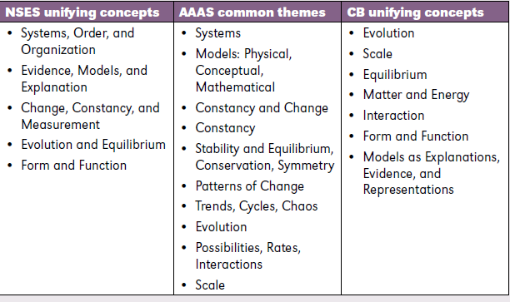
Precursors to the Crosscutting Concepts
Notes:
Where did they come from
- In previous documents, but often ignored. They were in the mind of the teacher, and maybe affected instruction, but weren’t taught intentionally and explicitly.

Slide 33
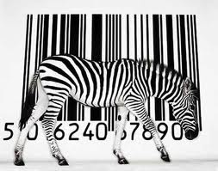
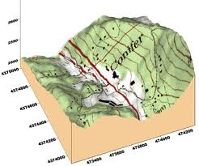

Patterns
Scale, Proportion, and Quantity
Cause and Effect
Framework p. 85
Notes:
Starts Page 85
1. Patterns. Noticing patterns of forms and events guide organization and classification, and they prompt questions about relationships and the factors that influence them.
2. Cause and effect: Mechanism and explanation. Events have causes, sometimes simple, sometimes multifaceted. A major activity of science is investigating and explaining causal relationships and the mechanisms that are working. Such mechanisms can then be tested across given contexts and used to predict and explain events in new contexts.
3. Scale, proportion, and quantity. In considering phenomena, it is critical to recognize what is relevant at different measures of size, time, and energy and to recognize how changes in scale, proportion, or quantity affect a system’s structure or performance. At a different scale it may not perform in the same way.

Slide 34
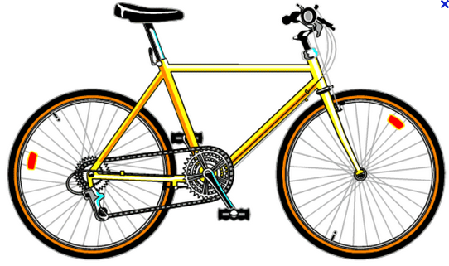
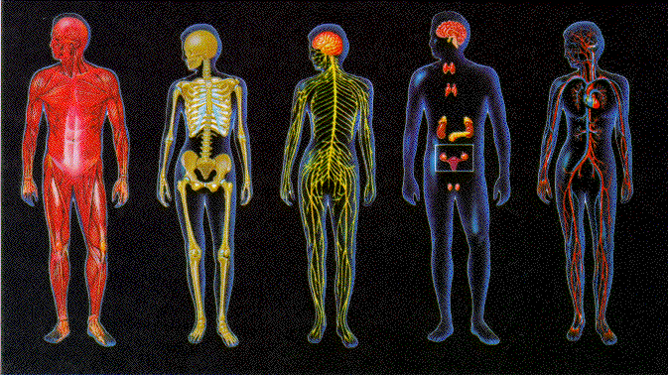

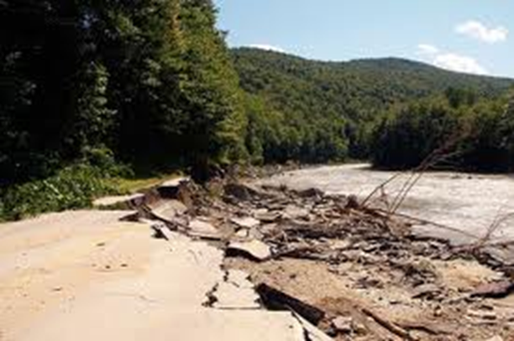
Structure and Function
Systems and System Models
Stability and Change
Energy and Matter
Notes:
4. Systems and system models. To understand a complex phenomena, it is helpful to break it into sub system. Defining the system under study—specifying its boundaries and making explicit a model of that system—provides tools for understanding and testing ideas that are applicable throughout science and engineering.
5. Energy and matter: Flows, cycles, and conservation. A big idea of science is that matter and energy are conserved – the total amount stays the same. It often changes form. Tracking the flow of energy and matter into, out of, and within systems helps one understand the systems’ possibilities and limitations. We track the energy coming from the sun and notice how it is converted into heat and winds.
6. Structure and function. The way in which an object or living thing is shaped or its composition and its substructure determine many of its properties and functions. Pedals and gears make the bike easy going up hill and fast going downhill.
7. Stability and change. For natural and built systems alike, there are conditions of stability such as a book on a table or repeated cycles. Some systems self adjust the system (sweating keeps us from overheating) but other systems can accelerate change, such as a fire or erosion

Slide 35
Crosscutting Concepts Activity
TASK: Exploring Seeds
DESCRIPTION: Compare the seeds that are given and develop a possible explanation for the differences you observed. Use the appropriate Crosscutting Concepts to help you make sense of the similarities and differences.
ORGANIZATION: Use the Crosscutting Concepts and your knowledge of seeds to investigate these seeds.
EXPLANATION: Provide an explanation for the structures of the seeds.
TOOLS: Magnifying glass, cutting device
QUESTIONS: What was the role of Crosscutting Concepts in the sense making for the seed activity? What is the role of Crosscutting Concepts in generalizing findings from investigations?
Notes:
CCC on the bottom of the second sheet.
10 minutes for exploration and note taking
Critical listeners should listen for CCC and prod for examples
Ask Critical listeners for examples of CCC and examples of how they were used

Slide 36
Discussion
What were some Crosscutting Concepts that were used in this activity to make sense about seeds?
Give examples of the way they were used?
Notes:
Note similarities/overlap between crosscutting concepts

Slide 37
Structure | Function

Slide 38
Pattern | Meaning

Slide 39
Cause | Effect

Slide 40
Relationships
Cause and Effect
Patterns
Systems
Structure and Function
Scale
Change and Stability
Matter and Energy
Notes:
Science is predicated on Cause and Effect – Structure and Function is a special case of cause and effect
Patterns provide utility to investigate and determine causality
Systems describe the phenomena under study in terms of Scale and quantity, change and stability, and the interactions of matter and energy.

Slide 41
Organizing the Crosscutting Concepts
Science is built on causality. The concept that phenomena have a cause that can be explained with evidence distinguishes science from other ways of knowing.
“Causation [that is] invoked to explain larger scale systems must be consistent with the implications of what is known about smaller scale processes within the system” Framework page 88
Notes:
This slide will introduce the rationale for Cause and Effect being the overarching crosscutting concept and the one that follows its connection to patterns, structure and function, and the other crosscutting concepts.
Connecting causation to systems opens the door to the idea that structure and function is a form of a cause and effect relation as well as to the importance of looking at scale.

Slide 42
Systems
Scale
Change and Stability
Matter and Energy
Causality
Cause and Effect
Structure and Function
Patterns
Notes:
A number of relationships exist between these ideas of crosscutting concepts. Perhaps systems are being described in terms of scale, stability , matter and energy. Causality may be engaging both the structure and function as well as cause and effect concepts.

Slide 43
Crosscutting Concepts
These concepts should become common and familiar touchstones across the disciplines and grade levels.
Explicit reference to the concepts, as well as their emergence in multiple disciplinary contexts, can help students develop a cumulative, coherent, and usable understanding of science and engineering.
Notes:
The idea that the universe makes sense is powerful for science learning. The Crosscutting Concepts help students make sense of the novel phenomena they encounter.

Slide 44
Which Practices were used in this activity and how?
Asking Questions and Defining Problems
Developing and Using Models
Planning and Carrying Out Investigations
Analyzing and Interpreting Data
Using Mathematics, Information and Computer Technology, and Computational Thinking
Constructing Explanations and Designing Solutions
Engaging in Argument from Evidence
Obtaining, Evaluating, and Communicating Information
Notes:
Talk with neighbors – 2 minutes
Ask for examples

Slide 45
Which Crosscutting Concepts were used in the Polymer activity and how?
Patterns
Cause and Effect
Scale, Proportion, and Quantity
Systems and System Models
Energy and Matter
Structure and Function
Stability and Change
Notes:
Note how CCC and Practices support each other

Slide 46
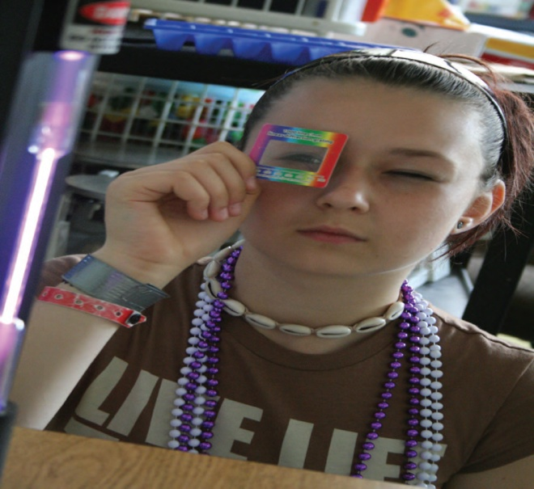
Connecting the Practices and Crosscutting Concepts
Providing empirical evidence to support assertions and listening to others’ arguments and analyzing the evidence they provide comes from the Practices.
The Crosscutting Concepts help generate evidence to support arguments.
Making Thinking Visible
is important for all 3 dimension of science
Notes:
Investigation to develop evidence to…
Supporting explanation to…
Engage in argument from evidence.
Evaluating and communicating information and findings.

Slide 47
Making Sense
Science is about making sense of things.
Crosscutting Concepts such as Structure and Function provide the tools for students to make sense of things and construct understanding.
Patterns can be used to support explanations and develop questions and support explanations.
Notes:
Not only for individual phenomena, but also for a range of related phenomena
Did evidence play a role in your investigation of the seeds?
Crosscutting concepts must be used in conjunction with practices and reflected up.
For deep learning students need to re

Slide 48
Reflection
I used to think ______________________________ about how science works, but now I know_______
__________________________________________. My thinking was changed by __________________
__________________________________________
Notes:
It is important to have students reflect on their learning.

Slide 49
Overview of
A Framework for K-12 Science Education
Susan Singer
Carleton College
Board of Science Education, National Academy of Science

Slide 50
Lunch
Please return before 12:45

Slide 51
Thoughts? Tweet #MDE3M

Slide 52
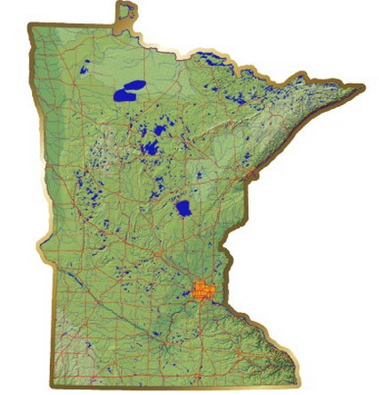


The Minnesota Context for the Framework and the
Next Generation Science Standards

Slide 53
Welcome
Rose Chu
Assistant Commissioner
Minnesota Dept. of Education

Slide 54
Minnesota is a national leader in STEM
Science, Technology, Engineering and Mathematics
High scores in international and national assessments
  TIMSS, PISA, NEAP
National leader for mathematics and science standards
  Algebra at 8 and Algebra II required for graduation
  Engineering standards in Science Standards
  Online standards resource “MN Frameworks” www.scimathmn.org/stemtc
  Innovative online assessments
Business/Higher Education/Informal Partnerships
  SciMathMN, MN STEM Network, MN High Tech. Assn.

Slide 55
Standards Periodic Review Cycle
Review Implement Stds. Review
‘06-07……...….Math ‘10-11……....….…..‘15-16
‘07-08…….…...Arts ‘10-11………….....…‘16-17
‘08-09…….…...Science ‘11-12………..... ‘17-18
‘09-10…….……L. Arts ‘12-13…….….…..‘18-19
‘09-10…….……Phy. Ed. ‘12-13……..……’18-19
‘10-11………....S. Studies ‘13-14………...‘19-20
Cycle TBD locally….. Health/W. Lang./CTE

Slide 56
New “national” science standards
- a two-step process
State
Standards
Notes:
Framework – getting the science and the practices right.
Collaborative agree on the way to express learning goals
Form the foundation for state standards

Slide 57
A new Vision of Science Leaning that leads to a new Vision of Teaching.
free download at
www.nap.edu

Slide 58
Three Dimensions of Science Learning
Scientific and Engineering Practices
Crosscutting Concepts
Core Ideas
Notes:
Key theme – good science learning consists of 3 dimensions. They should come together in to coherent and meaningful way, both for the student and the teacher. We look at them separately but they should be integrated in instruction
SEP – the skills for doing science – like do investigations, constructing explanations, communicating ideas, and using mathematical thinking,
– consideration for what scientists actually do,
skills for science inquiry and also being a thoughtful person
CCC – Concepts that cut across many disciplines, like patterns, cause and effect and energy
CI – the main concepts for life, earth and physical science that we want students to learn and be able to use.

Slide 59
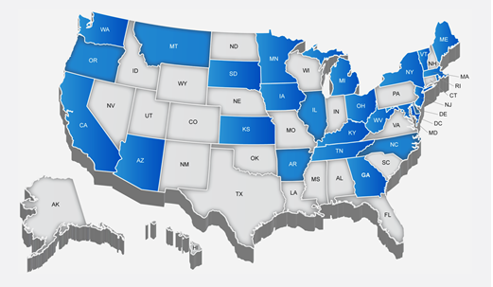

NGSS – A state-led effort
Roles for lead states
Review of drafts
Dissemination of the Vision
Implementation (Stakeholders)
Notes:
Since standard are the role of states, identifies 26 lead states.
Reviews
Have evaluated 4 drafts – team of about 30 – review individually, give online feedback, discussions vi conference call, prepare a state response and leaders meet personally.
Dissemination – 46 states have been involved in looking the message of the framework – Meetings with MN representatives – this session
Implementation – more than just teachers in classroom, businesses, policymakers, volunteers

Slide 60
Developing the Next Generation Science Standards
Mary Colson
Moorhead High School
NGSS Writing Team

Slide 61
The Process of Writing the NGSS
Writing team is 41+ people: K-12 educators, scientists, engineers, curriculum directors, education researchers, state sci. supervisors.
Process of writing, soliciting review, analyzing feedback, rewriting done in collaboration with lead states and critical stakeholders.
Writing team draft to lead states/critical stakeholders feedback to writing team
Feedback review and rewrite public draft. Done 1 time. Repeat. 2nd public draft Dec 2012.
Notes:
1. Composition of writing team (25 or so states represented, a few writers from Fmwk serve on writing team to provide continuity with and fidelty to the Framework.
2. Process – complex, time consuming, tight deadlines, Achieve managing the process (making sure that writers work on the most current version)
3. Overview of the steps of strategizing/writing/review process.
4. We are now rewriting (based on lead state review) for the 2nd public draft. Actually, some of writing team are still stuck in D.C.

Slide 62
MS.ESS-WC Weather and Climate Systems ( draft, example)
Students who demonstrate understanding can: Analyze maps or other graphical displays of large data sets to assess the likelihood and possible location of future severe weather events. [Clarifying Statement: Students could examine data sets on the frequency, magnitude, and resulting damage from severe weather events (hurricanes, floods, droughts) to determine the regions most at risk from these hazards. Graphical displays of large data sets should be grade-appropriate.] [Assessment Boundary: Reading a weather map is not assessed.]
Science and Engineering Practices Analyzing and Interpreting Data Use graphical displays (e.g., maps) of large data sets to identify temporal and spatial relationships. (a) | Disciplinary Core Ideas ESS3.B: Natural Hazards . . . However, mapping the history of natural hazards in a region, combined with an understanding of related geologic forces can help forecast the locations and likelihoods of future events. (a) | Crosscutting Concepts Patterns Patterns in rates of change and other numerical relationships can provide information about natural and human designed systems. (a)
Notes:
Parts of a standard– performance expectation and foundation box
Look at pe, cs and ab – value of CS and AB in feedback from states and public
Point out the way the statements (in foundation box) from framework support the PE.
Fmwk like the old NSES . . . NGSS fleshes out how fmwk informs instruction/curriculum dev/assessment
Value to sci education: Leads to robust understanding of the entire enterprise of doing science and engineering – Italian geologists jailed and risk assessment

Slide 63
Supporting the Vision of the Framework
Rose Chu, Minn. Dept. of Education
Barbara Kaufmann, 3M
Kay O’keefe, Medtronic Foundation (retired)
Clay Parker, Sciogen Corporation
Doug Paulson (facilitator)

Slide 64
Impressions
What is your impression of the vision of the Framework?
What do you see as its value?

Slide 65
Small Group Discussion
How can we engage Minnesota in supporting the vision of science learning from the Framework?
Introductions
Discuss the question
Put comments and questions on cards and give the “Critical Listeners”

Slide 66
Panel Discussion
How can we engage Minnesota in supporting the vision of science learning from the Framework?
Questions and comments from cards
Comments from “Critical Listeners”

Slide 67
Breakouts
2:00
Pink Dots: Implementation Panel (2:00- 2:50)
Green Dots: Innovation Tour (2:00 – 2:50)
Business Group - Room 2608 (2:00 – 3:30)
3:00
Pink Dots: Innovation Tour (3:00 – 3:50)
Green Dots: Implementation Panel (3:00-3:50)

Slide 68
How can we help educators transition to the vision of the Framework?
Mary Colson, Moorhead High School
Lee Schmitt, Hamline University
John Truedson, Bemidji State University
John Olson, (facilitator)

Slide 69
Which aspects of the Framework do you see as the biggest challenges and opportunities in instructional practices?
How do you see the Science and Engineering Practices and the Crosscutting Concepts fitting into our present Minnesota standards?
What kind of professional development is needed to help teachers implement these instructional practices?
What support is need from administrators, higher education and informal education and the community at large to accomplish this

Slide 70
Thank you for attending
Note contacts and resources on the back of the first sheet.
Please complete the evaluation, tear it off and leave it at the front table.
Contact John or Doug for further questions.

Slide 71
How can we help educators transition to the vision of the Framework?
Joe Alfano, Minneapolis Public
Schools
Tamara Moore, Univ. of Minn. STEM Center
Patti Paulson, Bethel University
Steve Walvig, Bakken Museum
Doug Paulson, (facilitator)

Slide 72
Which aspects of the Framework do you see as the biggest challenges and opportunities in instructional practices?
How do you see the Science and Engineering Practices and the Crosscutting Concepts fitting into our present Minnesota standards?
What kind of professional development is needed to help teachers implement these instructional practices?
What support is need from administrators, higher education and informal education and the community at large to accomplish this

Slide 73
Thank you for attending
Note contacts and resources on the back of the first sheet.
Please complete the evaluation, tear it off and leave it at the front table.
Contact John or Doug for further questions.

