Slide 1
Embed Analytics in Math Education
Kenneth Chelst, Thomas Edwards, Asli Ozgun-Koca
kchelst@wayne.edu, t.g.edwards@wayne.edu, aokoca@wayne.edu
Wayne State University
Detroit, MI

Slide 2
Warning!!! Hazardous to your workload stability Once your eyes are opened ➔see Difficult to erase memories

Slide 3
Our Mission
Develop mathematics concepts within realistic decision contexts relevant to students.
Demonstrate that mathematics is a tool for exploring options and determining the preferred solution and not simply a process for getting the correct answer.
Design and disseminate mathematics curriculum that develops and reinforces the higher-order thinking and skills described in the Common Core Mathematical Practices, MP1-MP8.

Slide 4
Common Core – Mathematics Practices
MP1 Make sense of problems and persevere in solving them.
MP2 Reason abstractly and quantitatively.
MP3 Construct viable arguments and critique the reasoning of others.
MP4 Model with mathematics.
MP5 Use appropriate tools strategically.
MP6 Attend to precision.
MP7 Look for and make use of structure.
MP8 Look for and express regularity in repeated reasoning.

Slide 5
Math’s Current State
K-12 math is descriptive NOT prescriptive
What is? And Not what should be?
IBM VP Brenda Dietrich
Math involves finding the correct answer and not about defining and evaluating good and better alternatives
Nothing to discuss except if multiple ways to get same answer
Word problems: 1-4 sentences

Slide 6
Math Content’s Relative Sophistication
Few contexts over and over and over again
follow a recipe,
travel in a car, train, plane, on foot,
Run, walk, trot, etc.
build fence around a yard,
paint a room
fill a bathtub or swimming pool
Sale – discount x%

Slide 7
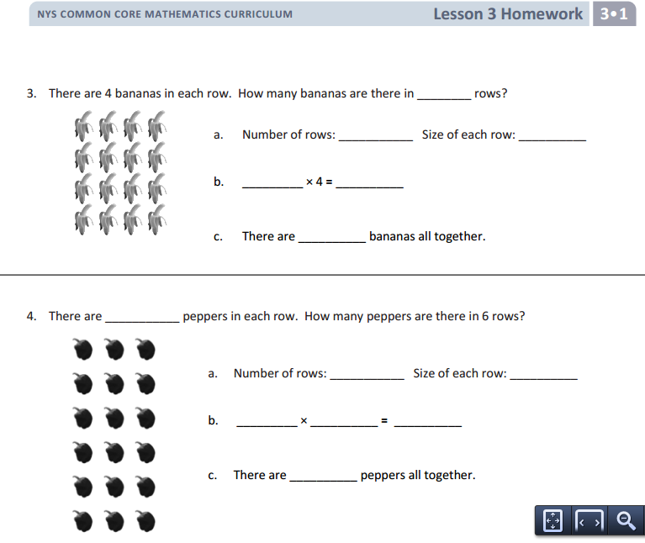
3rd Grade Mathematics Counting fruits, vegetables, flowers ad nauseam

Slide 8
3rd Grade Science

Slide 9
Middle School Math Core Concepts
Proportional
Ratios
Rates

Slide 10
7th Grade Math

Slide 11
7th Grade Science

Slide 12
Ratio - Current
Thirty children in class
Ratio of boys to girls is 3:2
How many boys and girls in class?
Concern
Use math to describe what is
How did they find the ratio if they did not count the number of boys and girls?

Slide 13
Ratio of boys to girls – Why care?
Provide contexts in which you would care
Stores – merchandise mix
TV audience – marketing messages
Others

Slide 14
Rates – Standard question
Travel x miles in y hours, what was my rate of speed? (Descriptive)
Planning a 240 mile trip. How long will it take? (prescriptive but BORING?)
How many different questions can you ask about how long is it going to take to get from A ➔ B?...

Slide 15
Rates: Collect data ➔ Predictive ➔ Plan
Reading Materials | Novel (seconds) | Textbooks-Science/Social Studies (seconds) | Informational Text (seconds)
1 page
5 pages
Average Unit Rate

Slide 16
Rates – Others?
Exercise and burn calories
Glacier melting
Disease rates…

Slide 17
Algebra I (& II) Two equations in two unknowns Dumb, Dumber and Dumbest Word Problems
Janie rented 5 videos. They were a mix of $2 and $3 rentals. She spent a total of $13 dollars. How many $2 dollar videos and $3 dollar videos did she rent?
Do we really want to teach our children that solving simultaneous equations is how we solve problems instead of just counting how may $2 videos she rented?
The circumference of a rectangle is 108 cm. The length is 5 times the width. What is the length of the rectangle?
How would you ever know that the length is 5 times the width without first measuring the length and width? And then amnesia set in!!
Germinder has 3 more quarters than dimes. The total value of her dimes and quarters is $10.50. How many dimes and quarters does he have?
How would Germinder know he has 3 more quarters than dimes if he had not counted them first? Did he really forget to record the values?

Slide 18
Farmer U. R. L. Fool
Mr. Fool when to market and bought a total of 60 chickens and pigs.
One morning Mr. Fool was lying on the ground. All he could see were his animals’ feet.
Mr. Fool counted the total number of feet➔156 feet
How many chickens and how many pigs does Mr. Fool have?

Slide 19
What do kids see and experience
Food (nutrition, storage, consumption)
Clothing
Sports – Personal and professional
Exercise
Entertainment
Education
Transportation
Stores
Crime and safety
Health
Family and household
Work
Pets
Home
Environment
Vacations
Society & Government
Social media

Slide 20
Bottom Line
Focus on what should be and not what is? Decisions
Opportunities for multiple solutions
Different answers
Lots of things to discuss
Learn where numbers come from
Experiments and Decisions
Info on web: calories in meals and burn calories with different exercise regimes.
Rich array of scenarios around child’s decision making world

